Slide 1

Biometric Student Attendance App
UI Design and Implementation

Slide 2

Introduction
The user interface (UI) design and implementation process for a mobile attendance system. This system aims to streamline the attendance management process through the integration of biometric authentication, real-time tracking, and comprehensive reporting

Slide 3
Agenda
General Users
Instructors
Students
Presentation Title

Slide 4


General Users
UI Design and implementation

Slide 5
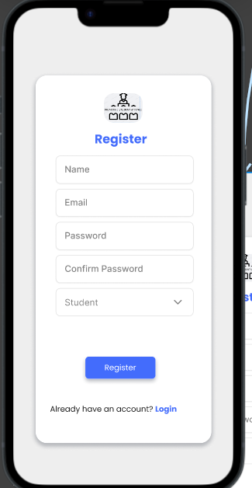
Registration Page
This is for users to actually
be registered in the application.

Slide 6
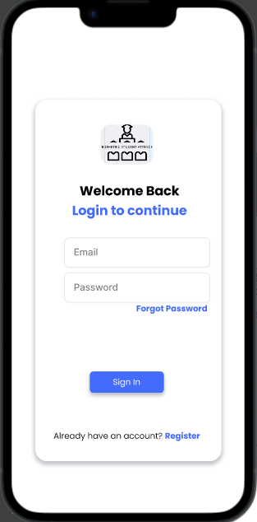
Login Page
This is for users to sign-in to
have access to their account
in the application.

Slide 7
Instructors
SYSTEM MODELLING & design

Slide 8
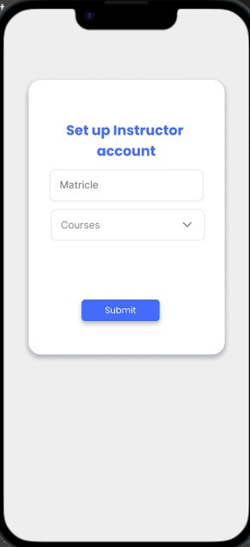
Instructor’s dashboard Page Setup instructor account
This page is for lectures to be
map to the courses they teach.

Slide 9
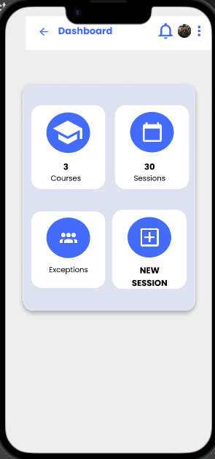
Instructor’s dashboard Page
Instructors have their
Dashboard so as to easily
Manage attendance sessions
And reports.

Slide 10
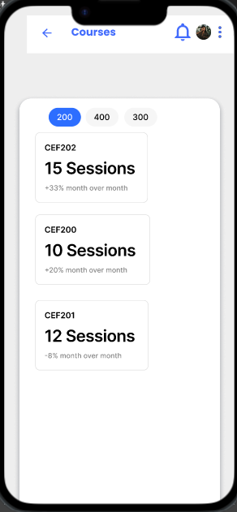
Instructor’s dashboard Page Courses
Courses Screen is to show
the instructor courses.

Slide 11
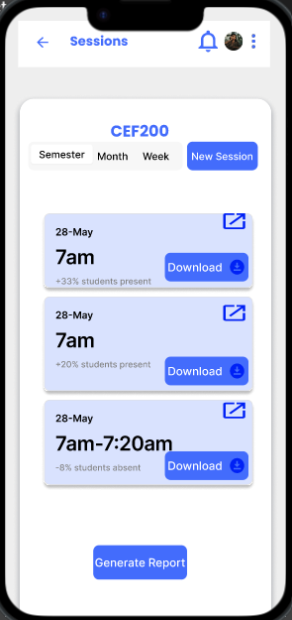
Instructor’s dashboard Page Sessions
Sessions is for instructors to
View and generate reports of
Past sessions.

Slide 12
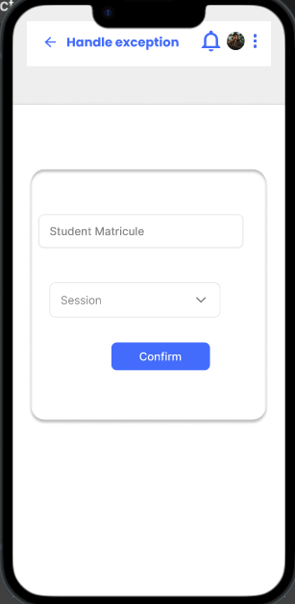
Instructor’s dashboard Page Exceptions
Exceptions is for instructors
to able to handle attendance
for special circumstances.

Slide 13
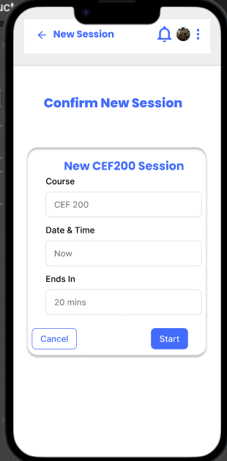
Instructor’s dashboard Page New Session
New session is for instructors
To create a new attendance
Session for students to mark
their attendance.

Slide 14
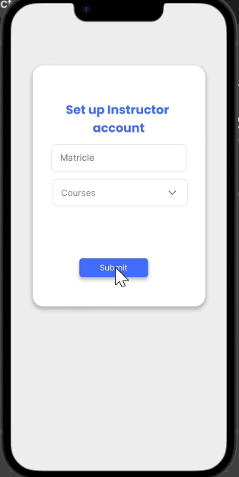
Instructors. Instructor’s User journey

Slide 15
STUDENTS
UI DESIGN AND IMPLEMENTATION

Slide 16
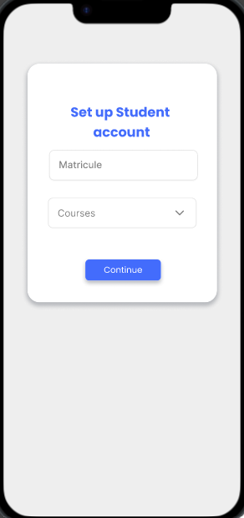
Students Student’s Account
The student here actually
selects his/her courses to
offer for that semester.

Slide 17
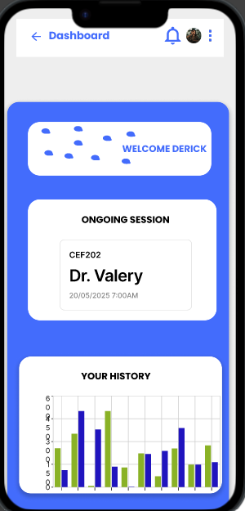
Students Student’s Dashboard
Student’s dashboard is for
the student to mostly view his/her
history or ongoing session.

Slide 18
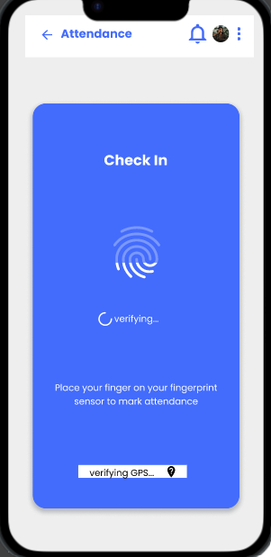
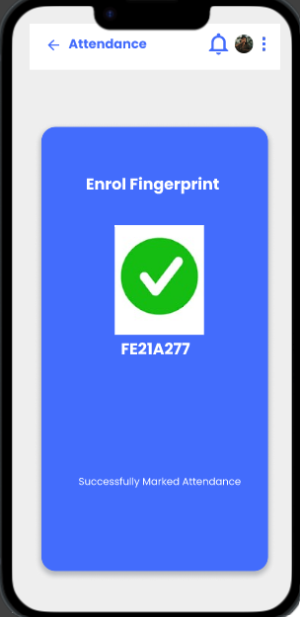
Students Student’s Ongoing session
After the student’s dashboard,
He/she takes the ongoing
Session and takes the attendance
Through his/her fingerprints.

Slide 19
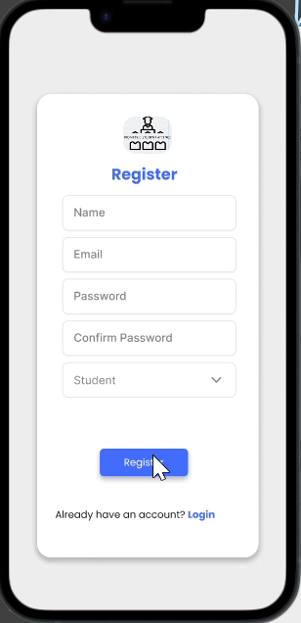
Students. Student’s User journey

Slide 20


Conclusion
The development of the Mobile Attendance System aims to revolutionize the way attendance is tracked and managed in educational and professional environments. By integrating cutting-edge technologies such as biometric authentication, real-time attendance tracking, and comprehensive reporting, this system offers a robust solution to modern attendance challenges.

Slide 21




Thank you

